Slide 1
Data Focused Python 95888
Carnegie Mellon University
Week 4: Intro to Pandas

Slide 2
Pandas
Pandas is a library written for the Python programming language for data manipulation and analysis.
In particular, it offers data structures and operations for manipulating numerical tables and time series.
>>> import pandas as pd

Slide 3
Pandas: Series
A Series is a one-dimensional sequence of values, together with a same-length sequence of labels: the index of the Series
By default, the index values are 0 through N-1
>>> s1 = pd.Series([3, 5, 2, 4])
>>> s1
0 3
1 5
2 2
3 4
dtype: int64

Slide 4
Pandas: Series (cont.)
>>> s1.values
array([3, 5, 2, 4], dtype=int64) # ndarray
>>> s1.index
RangeIndex(start=0, stop=4, step=1) # like range
Index does not have to be int!
>>> s2 = pd.Series([4, 2, 1, 5],
index=['a','x','C','?'])
>>> s2
a 4
x 2
C 1
? 5
dtype: int64
Notes:
Advanced question: indexes do not have to be ints – but what are the restrictions on indexes?

Slide 5
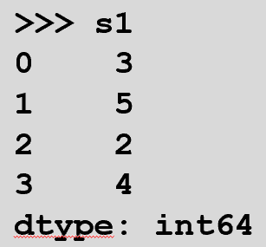
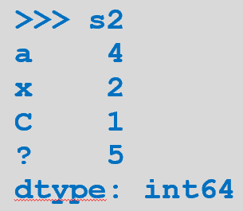
Pandas: Series (cont.)
>>> s2.values
array([4, 2, 1, 5], dtype=int64)
>>> s2.index
Index(['a', 'x', 'C', '?'], dtype='object’)
Indexing specific element – like with lists
>>> s1[2]
2
>>> s2['?'] # named index
5
>>> s2[3] # can use integer index!
5

Slide 6
Series and dict
It's easy to construct a Series from a dict
Index will be from keys, values from values
Prior to Python 3.6, indexes were sorted
Since 3.6 indexes are in same order as dict key insertion
>>> d1 = {'X': 123.2, 'AAPL': 543, 'CSCO': 47.7}
>>> s3 = pd.Series(d1) # dict: stock symbol (ticker), price
>>> s3
X 123.2
AAPL 543.0
CSCO 47.7
dtype: float64

Slide 7
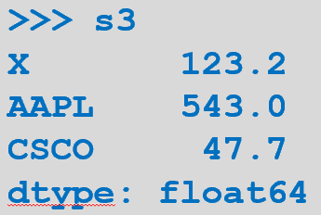
Series Index Check
You can use dict-style notation to check whether a Series does or does not have a specific index
>>> 'AAPL' in s3
True
>>> 'GS' in s3
False

Slide 8
Series Arithmetic, Slicing, and Indexing
Arithmetic, slicing, and indexing work in a Series as one would expect from ndarray

Slide 9
Series Arithmetic, Slicing, and Indexing (cont.)
Scalar arithmetic:
>>> s1
0 3
1 5
2 2
3 4
dtype: int64 >>> s1 *= 2
>>> s1
0 6
1 10
2 4
3 8
dtype: int64

Slide 10
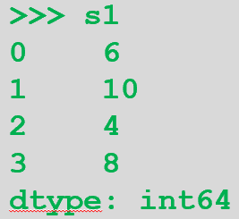
Series Arithmetic, Slicing, and Indexing (cont.)
>>> s4 = s1 / 2
>>> s4
0 3.0
1 5.0
2 2.0
3 4.0
dtype: float64 >>> s1 //= 2 # s1 = s1 // 2 – “floor” division (round down to int)
>>> s1
0 3
1 5
2 2
3 4
dtype: int64

Slide 11
Series Arithmetic, Slicing, and Indexing (cont.)
Series arithmetic:
>>> s1 + s1
0 6
1 10
2 4
3 8
dtype: int64 >>> np.sqrt(s1) # math.sqrt() does not work on pandas!
0 1.732051
1 2.236068
2 1.414214
3 2.000000
dtype: float64
Advanced: If you were to use math.sqrt() in a for loop on floats, it’ll be faster than np.sqrt(). Why?
Notes:
math.sqrt does not work on pandas – and it hasn’t been optimised for series/dataframes, anyway.

Slide 12
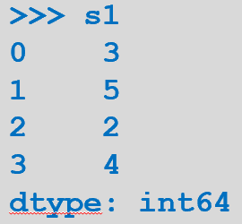
Series Arithmetic, Slicing, and Indexing (cont.)
Series slicing:
>>> s1[:2] # to but not including s1[2]
0 3
1 5
dtype: int64 >>> s3[1:] # from second to last element
AAPL 543.0
CSCO 47.7
dtype: float64
>>> s3['AAPL':'CSCO'] # 'AAPL' to and including 'CSCO'
AAPL 543.0
CSCO 47.7
dtype: float64

Slide 13
Series Arithmetic with Differing Indexes
If indexes differ between two Series, arithmetic will yield NaN (not a number)
NaN can mean missing value, or NA (not applicable)
>>> s6 = pd.Series([3,7,1],
index=pd.RangeIndex(2,5))
>>> s6
2 3
3 7
4 1
dtype: int64
Notes:
Appending series together (with and without ignoring index consistency): https://www.geeksforgeeks.org/python-pandas-series-append/

Slide 14
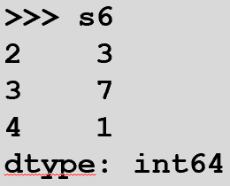
Series Arithmetic with Differing Indexes (cont.)
>>> s1p6 = s1 + s6
>>> s1p6
0 NaN # index exists in s1 but NOT s6
1 NaN # index exists in s1 but NOT s6
2 5.0 # index exists in s1 and s6
3 11.0 # index exists in s1 and s6
4 NaN # index exists in s6 but NOT s1
dtype: float64
Notice that indexes are matched first and then the addition takes place.

Slide 15
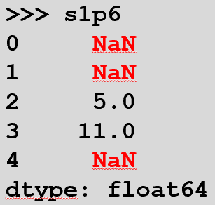
Series Arithmetic with Differing Indexes (cont.)
pd.isnull(Series) and pd.notnull(Series) yield Boolean indexes of NaN and non-NaN items, respectively
Really good for analysing unclean data
>>> pd.isnull(s1p6) # or pd.isna(s1p6)
0 True
1 True
2 False
3 False
4 True
dtype: bool

Slide 16
Series Arithmetic with Differing Indexes (cont.)
Boolean indexing revisited (from last lecture)!
>>> s1p6[pd.notnull(s1p6)] # or s1p6[pd.notna(s1p6)]
2 5.0
3 11.0
dtype: float64

Slide 17
Pandas: DataFrame
A DataFrame is "like" a spreadsheet, with named columns and N rows
Idea borrowed from R data.frame
Easy to build from a dict, with column names as keys and equal-length lists as values in rows
>>> d2 = {'Ticker': ['A','B','X','G'],
'CEO_buy': [True, False, False, False],
'Return_%': [11.1, -4.4, 12, 23.4]}
>>> f1 = pd.DataFrame(d2)

Slide 18
Pandas: DataFrame (cont.)
>>> f1
Ticker CEO_buy Return_%
0 A True 11.1
1 B False -4.4
2 X False 12.0
3 G False 23.4
>>> type(f1)
<class 'pandas.core.frame.DataFrame'>

Slide 19
DataFrame Column Access
One way to retrieve a column, as a Series:
>>> f1['CEO_buy']
0 True
1 False
2 False
3 False
Name: CEO_buy, dtype: bool
Columns in a dataframe are Series:
>>> type(f1['CEO_buy'])
<class 'pandas.core.series.Series'>

Slide 20
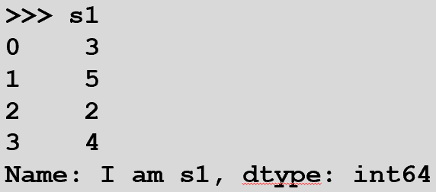
Renaming a Series
Notice the name attribute in the previous slide
To (re)name a Series:
>>> s1.name = 'I am s1' # renaming a previous series
The name of a series will become the column name in a dataframe
>>> pd.DataFrame(s1) # convert s1 to a data frame
I am s1
0 3
1 5
2 2
3 4
Notes:
If you do not give a name to a series, it will be automatically named with an int when you try to convert it to a df.

Slide 21
DataFrame Column Access (cont.)
Another way to retrieve a column is by its column name:
>>> f1.CEO_buy # we access col name not the name of the series
0 True
1 False
2 False
3 False
Name: CEO_buy, dtype: bool
Will not work if column name contains space character(s) or operator symbols (like / or %)
A series’ name has no effect on how you access the column in a df
i.e. once inside a df, a series name has no effect, only the column name matters
Notes:
f1.name is name of column, not name of series. You can change the name of the series but that will not change how you access the df – i.e. once inside a dataframe, changing a series’ name has no effect on how you access it.

Slide 22
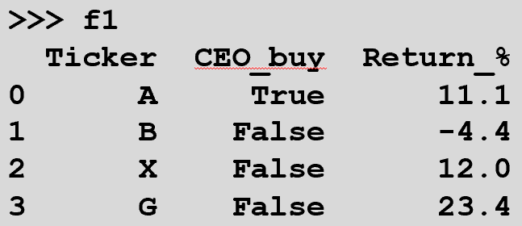
DataFrame Row
One way to retrieve a row, as a Series:
>>> f1.loc[2] # retrieve row 2
Ticker X
CEO_buy False
Return_% 12
Name: 2, dtype: object
# rows in a dataframe are also series
>>> type(f1.loc[2])
<class 'pandas.core.series.Series'>

Slide 23
DataFrame Cell
Three ways to retrieve a cell:
>>> f1['CEO_buy'][2] # column and row (opposite to ndarray!)
False
>>> f1.loc[2]['CEO_buy'] # row and column
False
>>> f1.loc[2, 'CEO_buy'] # row and column
False
The first way above of accessing a cell is not recommended as it’s not as efficient as the other two
Notes:
f1['CEO_buy'][2] # column and row – this is the reverse of ndarrays where row is the first element and column the second
Regarding access efficiency: https://pandas.pydata.org/pandas-docs/stable/user_guide/indexing.html
However, if I were to specify a range, the opposite way of indexing works (just to add to you confusion)!
f1[2:3]['CEO_buy']

Slide 24
DataFrame: Add a Column
You add a column to a DataFrame much as you would add a key/value pair to a dict:
>>> f1['P/E'] = 20.5 # scalar (all values in column get this)
>>> f1
Ticker CEO_buy Return_% P/E
0 A True 11.1 20.5
1 B False -4.4 20.5
2 X False 12.0 20.5
3 G False 23.4 20.5

Slide 25
DataFrame: Add a Column (cont.)
If you want to give specific values to each row in a new column:
>>> f1['PEG_ratio'] = [1.7, 0.9, 2.2, 1.1] # iterable (list, set, etc.)
>>> f1
Ticker CEO_buy Return_% P/E PEG_ratio
0 A True 11.1 20.5 1.7
1 B False -4.4 20.5 0.9
2 X False 12.0 20.5 2.2
3 G False 23.4 20.5 1.1
# can also do, for e.g.: f1['PEG_ratio'] = {1.7, 0.9, 2.2, 1.1}
# (but order may be different!)
Notes:
iterable means you can provide a tuple or set.

Slide 26
DataFrame: Delete a Column
>>> del f1['P/E']
>>> f1
Ticker CEO_buy Return_% PEG_ratio
0 A True 11.1 1.7
1 B False -4.4 0.9
2 X False 12.0 2.2
3 G False 23.4 1.1

Slide 27
DataFrame: Add a Row
Add a row to a DataFrame using loc:
>>> f1.loc[4] = [ 'Z', True, 8.2, 1.3 ]
>>> f1
Ticker CEO_buy Return_% PEG_ratio
0 A True 11.1 1.7
1 B False -4.4 0.9
2 X False 12.0 2.2
3 G False 23.4 1.1
4 Z True 8.2 1.3

Slide 28
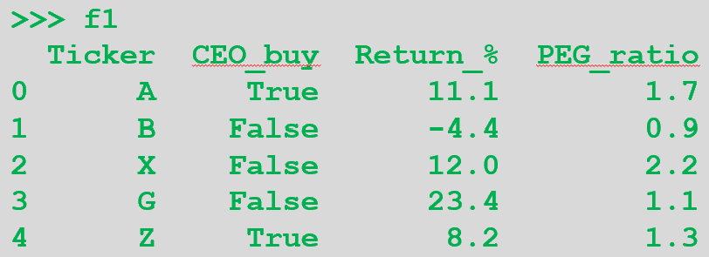
DataFrame: Add a Row (cont.)
If the data types of the new row don't match the existing column types, the column types will be upcast!
>>> f1c = f1.copy()
>>> f1c.loc[.5] = 12 # upcast index and columns as required!
>>> f1c
Ticker CEO_buy Return_% PEG_ratio
0.0 A 1 11.1 1.7
1.0 B 0 -4.4 0.9
2.0 X 0 12.0 2.2
3.0 G 0 23.4 1.1
4.0 Z 1 8.2 1.3
0.5 12 12 12.0 12.0
# notice that the rows are out of order, too. You need to sort them after adding a new row.
Notes:
Notice also, that the rows are “out of order” because 0.5 should be the second row. This is what happens when you add new rows (and columns) – they get appended to the end. You can sort the df by calling f1c.sort_index(inplace=True) (see sorting section at the end of this lecture)

Slide 29
DataFrame: Delete a Row
Deleting the problem row will not "de-upcast"--beware!
>>> f1c.drop(0.5) # specify index to drop
Ticker CEO_buy Return_% PEG_ratio
0.0 A 1 11.1 1.7
1.0 B 0 -4.4 0.9
2.0 X 0 12.0 2.2
3.0 G 0 23.4 1.1
4.0 Z 1 8.2 1.3

Slide 30
DataFrame Slicing and Indexing
Slicing and indexing works for DataFrames much as for Series
>>> a12 = np.arange(12)
>>> a12
array([ 0, 1, 2, 3, 4, 5, 6, 7, 8, 9, 10, 11])
>>> a12.reshape(4, 3) # 4 rows, 3 columns
array([[ 0, 1, 2],
[ 3, 4, 5],
[ 6, 7, 8],
[ 9, 10, 11]])

Slide 31
DataFrame Slicing and Indexing (cont.)
>>> f2 = pd.DataFrame(a12.reshape(4, 3),
index = ['r0', 'r1', 'r2', 'r3'],
columns = ['c0', 'c1', 'c2'])
>>> f2
c0 c1 c2
r0 0 1 2
r1 3 4 5
r2 6 7 8
r3 9 10 11
>>> f2['c0']
r0 0
r1 3
r2 6
r3 9
Name: c0, dtype: int32
We specify index values here manually (unlike what we do
on slide 17)
Notes:
Here we are specifying the index values for the rows (as opposed to what we do in slide 17 when the indexes for each row is automatically generated).

Slide 32
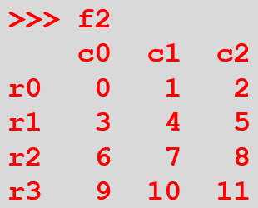
DataFrame Slicing and Indexing (cont.)
>>> f2.loc['r1'] # row as a Series
c0 3
c1 4
c2 5
Name: r1, dtype: int32
>>> f2 % 3 == 0 # boolean statement – True or False?
c0 c1 c2
r0 True False False
r1 True False False
r2 True False False
r3 True False False

Slide 33
DataFrame Slicing and Indexing (cont.)
>>> f2[f2 % 3 == 0] *= 2 # Boolean indexing
>>> f2
c0 c1 c2
r0 0 1 2
r1 6 4 5
r2 12 7 8
r3 18 10 11
Works in exactly the same way as Numpy arrays (ndarray) from last week’s lecture

Slide 34
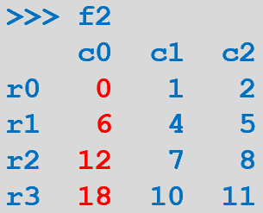
DataFrame Slicing and Indexing (cont.)
>>> f2.loc['r0':'r2'] # up to and including 'r2'
c0 c1 c2
r0 0 1 2
r1 6 4 5
r2 12 7 8
>>> f2[0:2] # as a convenience, for a row range
c0 c1 c2
r0 0 1 2
r1 6 4 5

Slide 35
DataFrame loc and iloc
Now that we have row index names we cannot use loc with row numbers (see slide 22), e.g.:
>>> f1.loc[2] # no problem
…
>>> f2.loc[2] # cannot do this any more
… TypeError: cannot do label indexing on <class 'pandas.core.indexes.base.Index’>
If you would like to index your rows in f2 with a number, you need to use iloc

Slide 36
DataFrame loc and iloc
loc gets rows and columns using labels
iloc uses row index and column integers
i.e. it only takes integers
>>> f2.loc['r1'] # all columns of row 'r1'
...
>>> f2.loc['r0':'r1'] # all columns of 'r0' through
c0 c1 c2 # and including 'r1'
r0 0 1 2
r1 6 4 5
>>> f2.loc[['r3', 'r1']] # all cols of 'r3' and 'r1'
c0 c1 c2
r3 18 10 11
r1 6 4 5
(List indexing. Similar to numpy
arrays from last lecture.)
Notes:
f2.loc[['r3', 'r1’]] – uses a list ([‘r3’, ‘r1’]) to index the df (similar to Numpy arrays).
To slice on column names as well use: f2.loc['r0':'r2','c0':'c1’]. Do not do this:
f2.loc['r0':’r2’]['c0':'c1’] as you will get unpredictable results.

Slide 37
DataFrame loc and iloc (cont.)
>>> f2.iloc[2] # all columns of row sub-2
c0 12
c1 7
c2 8
Name: r2, dtype: int32
>>> f2.iloc[1:3] # all columns of row sub-1
c0 c1 c2 # through but not including
r1 6 4 5 # row sub-3
r2 12 7 8
>>> f2.iloc[[3, 2]] # all cols of rows sub-3, sub-2
c0 c1 c2
r3 18 10 11
r2 12 7 8

Slide 38
DataFrame loc and iloc (cont.)
>>> f2.loc['r1', 'c2'] # row 'r1' col 'c2'
5
>>> f2.loc['r0':'r2', ['c2', 'c0']]
c2 c0
r0 2 0
r1 5 6
r2 8 12
>>> f2.iloc[[0, 3], [2, 0]] # tricky! (similar to numpy’s)
c2 c0
r0 2 0
r3 11 18

Slide 39
Arithmetic with Fill Values
We have seen that arithmetic combining DataFrames with unlike columns/rows introduces missing values (e.g. NaNs)
>>> f2
c0 c1 c2
r0 0 1 2
r1 6 4 5
r2 12 7 8
r3 18 10 11

Slide 40
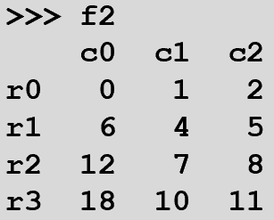
Arithmetic with Fill Values (cont.)
>>> f3 = f2.copy()
>>> f3['c3'] = [1, 3, 5, 7] # add a column
>>> f3 = f3.drop('r1') # delete a row
>>> f3
c0 c1 c2 c3
r0 0 1 2 1
r2 12 7 8 5
r3 18 10 11 7
>>> f2 + f3 # columns and rows get matched
c0 c1 c2 c3
r0 0.0 2.0 4.0 NaN
r1 NaN NaN NaN NaN
r2 24.0 14.0 16.0 NaN
r3 36.0 20.0 22.0 NaN

Slide 41
Arithmetic with Fill Values (cont.)
DataFrame named arithmetic functions allow you to specify a fill_value argument
The fill value is used in place of a missing value in one DateFrame or the other
But not if the value is missing in both DataFrames!
>>> f2.add(f3, fill_value = 0) # use add() instead of f2 + f2
c0 c1 c2 c3
r0 0.0 2.0 4.0 1.0
r1 6.0 4.0 5.0 NaN
r2 24.0 14.0 16.0 5.0
r3 36.0 20.0 22.0 7.0
# index [r1, c3] is missing in both f2 & f3 – hence the NaN

Slide 42
Sorting
To sort DataFrame rows, use sort_index()
For columns, sort_index(axis=1)
>>> f4 = pd.DataFrame(np.array(f2),
index=['a','d','b','c'],
columns=['z','x','y'])
>>> f4 # same data as f2, renamed rows, cols
z x y
a 0 1 2
d 6 4 5
b 12 7 8
c 18 10 11

Slide 43
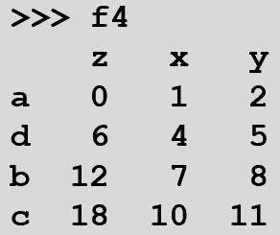
Sorting (cont.)
>>> f4.sort_index() # sort rows
z x y
a 0 1 2
b 12 7 8
c 18 10 11
d 6 4 5
>>> f4.sort_index(axis=1) # sort cols
x y z
a 1 2 0
d 4 5 6
b 7 8 12
c 10 11 18
Notes:
For sorting options, see: https://pandas.pydata.org/pandas-docs/stable/reference/api/pandas.DataFrame.sort_index.html
and https://www.geeksforgeeks.org/python-pandas-dataframe-sort_index/

Slide 44
Sorting (cont.)
>>> f4.sort_index(ascending=False).sort_index(axis=1)
x y z # rows descending, cols ascending
d 4 5 6
c 10 11 18
b 7 8 12
a 1 2 0
f4.sort_index(ascending=False) gets executed first and then sort_index(axis=1)
i.e. (f4.sort_index(ascending=False)).sort_index(axis=1)
Notes:
For sorting options, see: https://pandas.pydata.org/pandas-docs/stable/reference/api/pandas.DataFrame.sort_index.html
and https://www.geeksforgeeks.org/python-pandas-dataframe-sort_index/
and https://www.kite.com/blog/python/pandas-sort-values/

Slide 45
DataFrame Summary Statistics
DataFrame provides "the usual suspects" for summary statistics
>>> np.random.seed(1) # so we get the same random values each time
>>> a5 = np.random.randn(3, 3).round(3)
>>> a5
array([[ 1.624, -0.612, -0.528],
[-1.073, 0.865, -2.302],
[ 1.745, -0.761, 0.319]])
>>> f5 = pd.DataFrame(a5,
index = ['r0', 'r1', 'r2'],
columns = ['c0', 'c1', 'c2'])
Notes:
np.random.seed(1) - we set the seed so that we all get the same arrays as the examples in this lecture
For more info, see: https://stackoverflow.com/questions/21494489/what-does-numpy-random-seed0-do

Slide 46
DataFrame Summary Statistics (cont.)
>>> f5
c0 c1 c2
r0 1.624 -0.612 -0.528
r1 -1.073 0.865 -2.302
r2 1.745 -0.761 0.319
>>> f5.sum() # Series of column sums
c0 2.296
c1 -0.508
c2 -2.511
dtype: float64
# for sum of rows: f5.sum(axis=1)

Slide 47
DataFrame Summary Statistics (cont.)
>>> f5.mean()
c0 0.765333
c1 -0.169333
c2 -0.837000
dtype: float64
>>> f5.var() # unbiased variance
c0 2.538262
c1 0.807934
c2 1.789021
dtype: float64

Slide 48
DataFrame Summary Statistics (cont.)
>>> f5.describe()
c0 c1 c2
count 3.000000 3.000000 3.000000
mean 0.765333 -0.169333 -0.837000
std 1.593192 0.898852 1.337543
min -1.073000 -0.761000 -2.302000
25% 0.275500 -0.686500 -1.415000
50% 1.624000 -0.612000 -0.528000
75% 1.684500 0.126500 -0.104500
max 1.745000 0.865000 0.319000
Notes:
25%, 50%, and 75% are the lower, 50%, and upper percentiles.

Slide 49
DataFrame Summary Statistics (cont.)
Others include:
idxmin(), idxmax() # row of min, max for each col
median()
prod() # product of row vals by col
skew(), kurt() # skew, kurtosis
cumsum(), cumprod() # cumulative sum/product
diff() # arithmetic difference
pct_change() # % change row over row

